Slide 1
Rationalism vs. Empiricism: Foundations of Human Knowledge
Your Name
Institution Name
Date

Slide 2

Introduction to the Debate
Rationalism and Empiricism offer different sources of knowledge
The debate concerns how we know what we know
Impacts epistemology, metaphysics, and methodology
Still influences modern science and philosophy
Notes:
This presentation explores how rationalists and empiricists define knowledge, approach metaphysical issues, and apply their methods in philosophy and science.

Slide 3

Rationalism Explained
Knowledge arises from reason, not sensory experience
Innate ideas exist within the mind (e.g., math truths)
Truths are discovered through deduction
Key philosophers: Descartes, Spinoza, Leibniz
Notes:
Rationalists believe knowledge originates in reason and innate ideas. Descartes argued that logic and thought uncover truths independent of experience (Robinson, 2020).

Slide 4

Empiricism Explained
All knowledge comes from sense experience
The mind begins as a blank slate (Locke)
Knowledge is built through observation and reflection
Key figures: Locke, Berkeley, Hume
Notes:
Empiricists argue experience is the only true foundation of knowledge. Locke’s idea of the mind as a tabula rasa reflects this experiential basis (BonJour & Sosa, 2017).

Slide 5
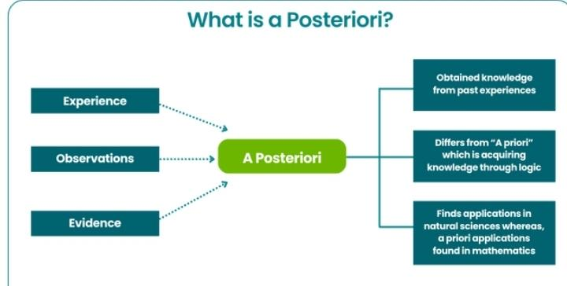
Epistemological Differences
Rationalists rely on a priori knowledge
Empiricists depend on a posteriori observation
Disagreement on source of truth and certainty
Rationalists favor logic; empiricists favor evidence
Notes:
Rationalists and empiricists differ on whether knowledge arises internally or externally. Rationalists trust reasoning, while empiricists require evidence and experience.

Slide 6

Metaphysical Implications
Rationalists emphasize mind over matter (dualism)
Empiricists focus on observable phenomena
Rationalism often leads to metaphysical certainty
Empiricism questions substance, self, and causality
Notes:
These traditions yield different metaphysical outlooks. Rationalists view mind and reason as core realities; empiricists often challenge the coherence of the “self.”

Slide 7

Methods and Attitudes
Rationalists use deductive reasoning and introspection
Empiricists rely on inductive reasoning and observation
Rationalism favors certainty; empiricism accepts uncertainty
Empiricism aligns with the scientific method
Notes:
Rationalism seeks internal coherence and logical necessity, while empiricism draws conclusions from observable data and adjusts based on new findings (Casullo, 2020).

Slide 8
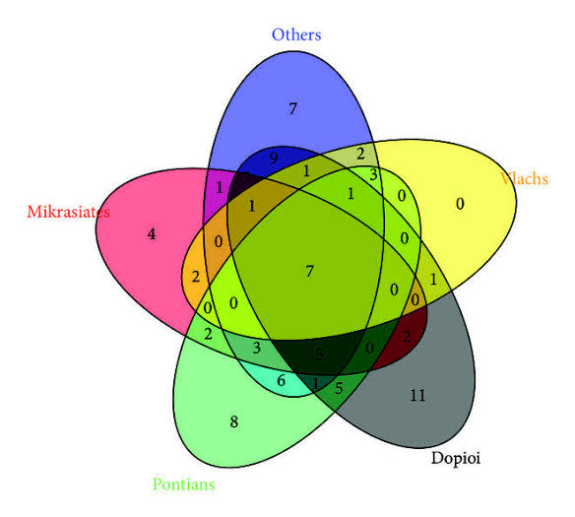
Which is More Convincing?
Empiricism dominates science and psychology
Rationalism underpins logic, math, and ethics
Each has value depending on context
Synthesis appears in thinkers like Kant and Quine
Notes:
While empiricism is central to science, rationalist thought is essential in ethics and mathematics. Many modern philosophers blend the strengths of both (Audi, 2015).

Slide 9

Personal Reflection
Empiricism provides practical tools for learning
Rationalism strengthens abstract and ethical reasoning
A combined approach seems most balanced
Each tradition helps answer different philosophical questions
Notes:
Personally, I favor empiricism for its real-world applications, but I value rationalism for moral reasoning and logic. A dual approach yields the richest insights.

Slide 10
References
Audi, R. (2015). Epistemology: A contemporary introduction to the theory of knowledge (3rd ed.). Routledge.
Casullo, A. (2020). Essays on A Priori Knowledge and Justification. Oxford University Press.
BonJour, L., & Sosa, E. (2017). Epistemic Justification. Wiley-Blackwell.
Robinson, H. (2020). Rationalism vs. Empiricism. Stanford Encyclopedia of Philosophy. https://plato.stanford.edu/entries/rationalism-empiricism/

